Slide 1
Set Calculator/ Subset Checker / set cardinality comparison tool

Slide 2
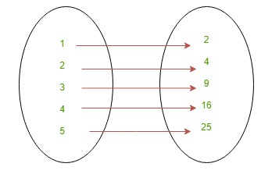
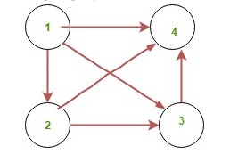
Presented To:
Mr. Husnain Haider
Presented by:
Azan Asghar BsCs-24026
Muhammad Arqam BsCs-24146
Faraz Waseem BsCs-24076
Aqib Ramzan BsCs-24074
Abdul Wasay BsCs-24006

Slide 3
Overview
Agenda:
Introduction to Sets
Set Operations
Basic Algorithm for Set Operations:
Subsets
Basic Algorithm for Subset Checker
Cordinality of Sets
Basic Algorithm for Cordinality Comparison Tool
Applications of sets and Real-World Examples
Thought-Provoking Questions and Discussion

Slide 4
Introduction To Sets
Set: A set is a collection of well-defined and distinct objects or elements.
Representation: A set is represented by a capital letter symbol and the number of elements enclosed in a curly brackets.
Ways of Describing Sets: There are three different ways of describing a set..
1. The Descriptive Method: 2. The Tabular Method: 3. Set-builder method:

Slide 5
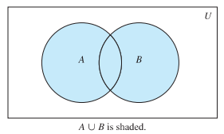
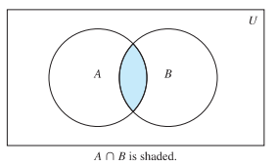
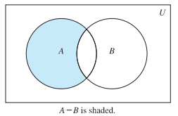
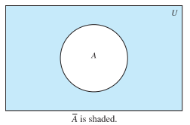
Set Operation
1- Union (∪): It is denoted as :A ∪ B.
2- Intersection (∩): It is denoted as A∩B.
3- Difference (−): It is denoted as A-B.
4- Complement (‘): It is denoted as U-A.

Slide 6
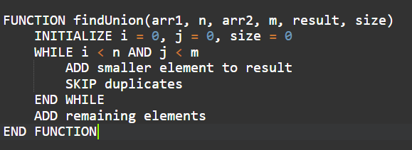
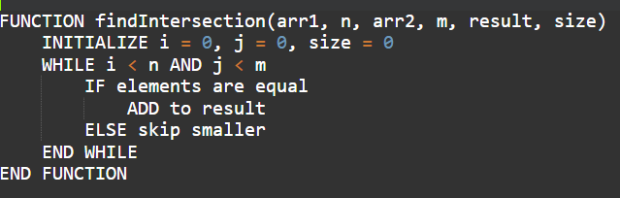
Basic Algorithm for Set Operations:
Union of two sets:
Intersection of two sets:

Slide 7
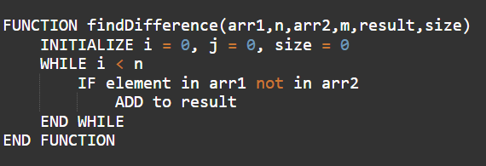
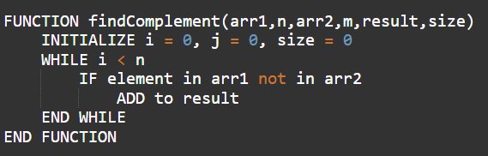
Basic Algorithm for Set Operations:
Difference of two sets:
Complement of two sets:
Note: Arr2 is Set B
Note: Arr2 is Universal Set

Slide 8
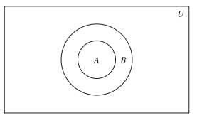
Subsets
Subset: A set A is a subset of another set B if every element of A is also an element of B. We denote this as A ⊆ B. Types Of Subsets: 1- Proper Subset : A proper subset is one that contains a few elements of the original set .We denote this as A ⊂ B. 2- Proper Subset : An improper subset, contains every element of the original set along with the null set.We denote this as A ⊂ B.
A ven diagram showing that set A is subset of set B.

Slide 9
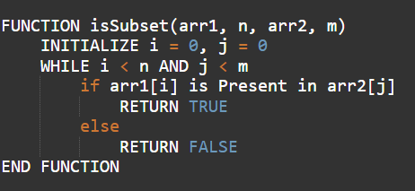
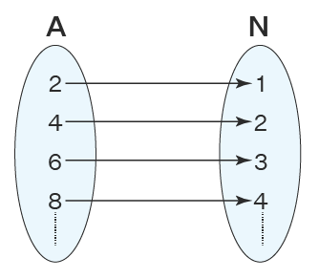
Basic Algorithm for Subset Checker
Subset Checker:

Slide 10
Cardinality of Sets
Cardinality of Sets :The cardinality of a set is simply the number of elements it contains. It's like counting the members of a club. The cardinality of a set A is often denoted as |A| or n(A). Examples: If A = {1, 2, 3}, then |A| = 3. Why is Cardinality Important? Cardinality is a fundamental concept in set theory and has applications in various fields, including: o Computer Science: Analysing data structures and algorithms. o Mathematics: Proving theorems and solving problems in discrete mathematics. o Probability and Statistics: Calculating probabilities and statistical measures.

Slide 11
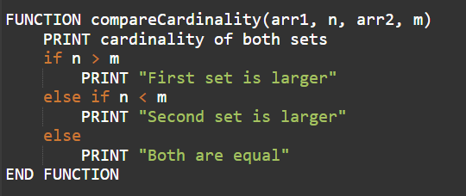
Basic Algorithm for Cordinality Comparison
Cordinality Comparison:

Slide 12

Applications of sets in Real Life
Kitchen: Kitchen is the most popular example of sets. Our mother always keeps the kitchen well arranged. The plates are kept separate from bowls and cups. Sets of similar utensils are kept separately.

Slide 13

Applications of sets in Real Life
School Bags: School bags of children's is also an example of sets. There are usually divisions in school bag were the sets of notebooks and textbooks are kept separately.

Slide 14

Applications of Subsets in Real Life
Library: A student has a list of books they need for research. The librarian uses the subset checker to verify if all requested books (subset) are available in the library’s collection (universal set).

Slide 15
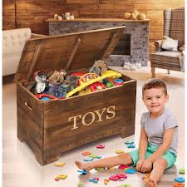
Applications of Subsets in Real Life
Toybox: A child wants to make sure all the toys they plan to take to school are already in their backpack. They check if every toy (subset) they’ve selected, like toy cars and a doll, is part of the larger collection of toys they have at home (universal set).

Slide 16

Applications of Cordinality in Real Life
Comparing Social Media Followers: Imagine you want to compare the number of followers on your social media account with that of a friend’s. You count your followers and compare the numbers. The person with more followers has the larger cardinality, which might indicate their popularity or influence on social media.

Slide 17

Applications of Cordinality in Real Life
Comparing Class Sizes: A teacher compares the number of students in two classes to determine which class is larger. By comparing the cardinality (number of students) of each class, the teacher can plan accordingly, such as deciding which class needs more resources.

Slide 18

Questions and Answers
Open the floor for questions and address any concerns or clarifications.

Slide 19
THE END

